Slide 1
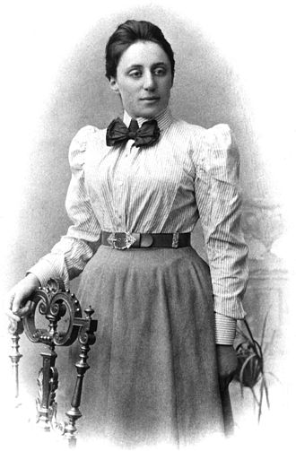
Emmy Noether
Notes:
# Name Emmy Noether # Textbook Knight, Physics for Scientists and Engineers: A Strategic Approach with Modern Physics, 3rd Edition, Chapter 9 Knight, Physics for Scientists and Engineers: A Strategic Approach with Modern Physics, 3rd Edition, Chapter 10 # Contributor Mai Hoang # Description Amalie Emmy Noether was a German mathematician and physicist known for her landmark contributions to abstract algebra and theoretical physics. One of her most remarkable discoveries in physics was Noether's theorem. The theorem states that every differentiable symmetry of the action of a physical system has a corresponding conservation law. In 1915, Noether was helping two other scientists, David Hilbert and Felix Klein, to understand Albert Einstein's general relativity theory when she proved Noether's first theorem. Upon receiving her work, Einstein wrote to Hilbert: "Yesterday I received from Miss Noether a very interesting paper... I'm impressed that such things can be understood in such a general way. The old guard at Göttingen should take some lessons from Miss Noether! She seems to know her stuff." Noether's theorem has become a fundamental tool of modern theoretical physics because of the insight it gives into conservation laws and also being practical calculation tool. For example, suppose that a new physical phenomenon is discovered. Noether's theorem provides a test for theoretical models of the phenomenon: if the theory has a continuous symmetry, then Noether's theorem guarantees that the theory has a conserved quantity, and for the theory to be correct, this conservation must be observable in experiments. # Sources https://en.wikipedia.org/wiki/Emmy_Noether # Photo https://upload.wikimedia.org/wikipedia/commons/thumb/e/e5/Noether.jpg/330px-Noether.jpg

